Slide 1
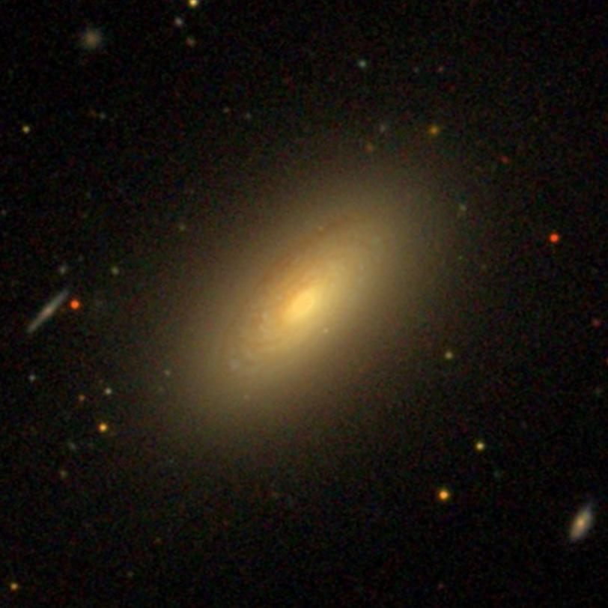
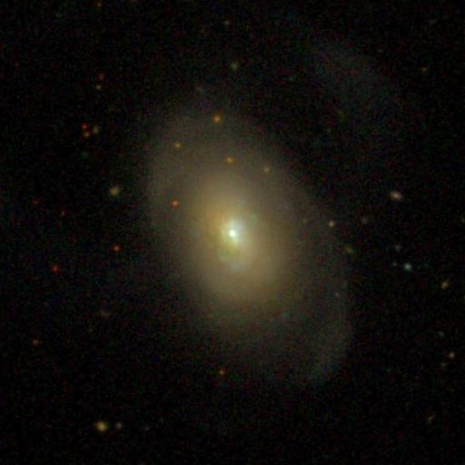
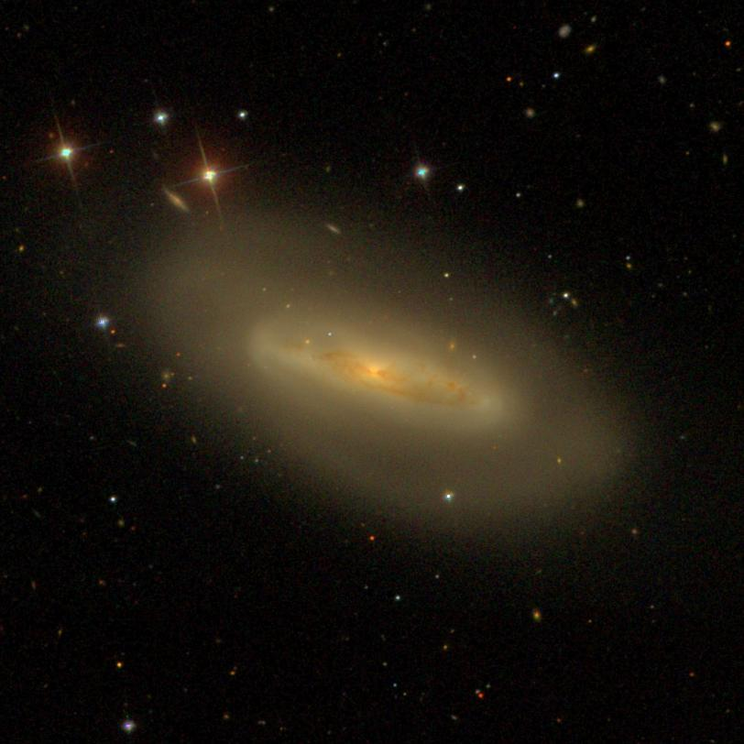

Slide 2
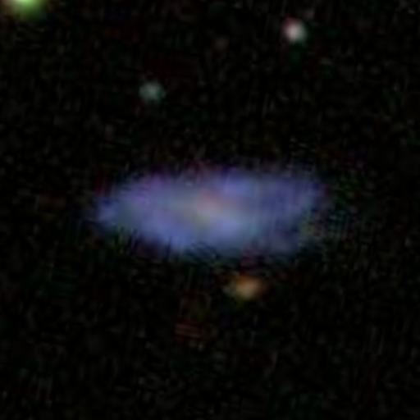
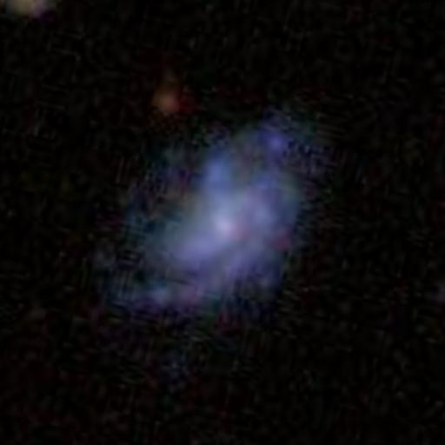
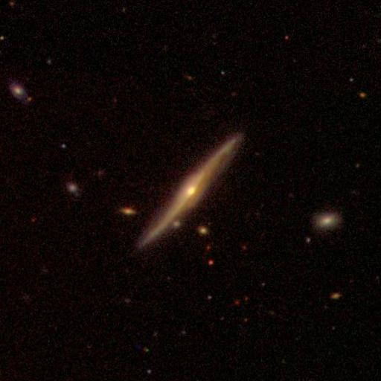
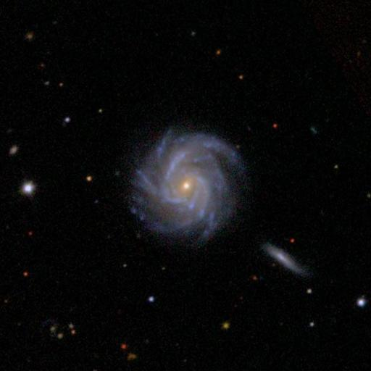
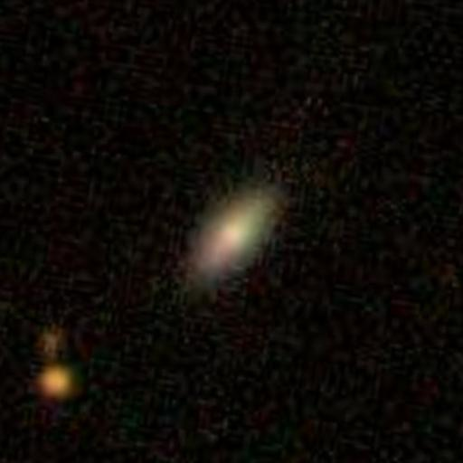
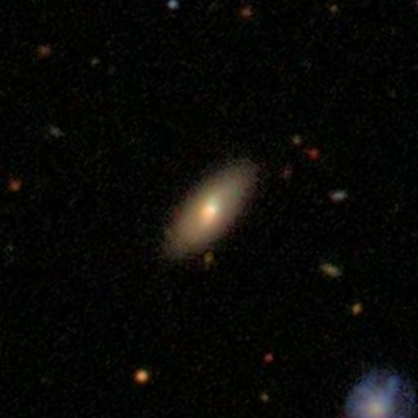
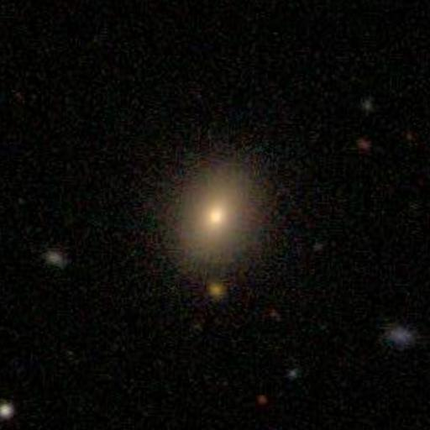
Notes:
Selection is dim
Featured: 587738615951065195 0.0545076 0.948941
Smooth: 588297864192458816 0.710452 0.177523
Selection is mid1
Featured: 587738946676719656 0.00857118 0.984678
Smooth: 587725979616346223 0.587785 0.436185
Selection is mid2
Featured: 587741600954712170 0.0722414 0.907000
Smooth: 588017704002322454 0.792188 0.184284
Selection is bright
Featured: 587736584436777018 0.00000 0.990000
Smooth: 587736523764465741 0.871157 0.0580000

Slide 3
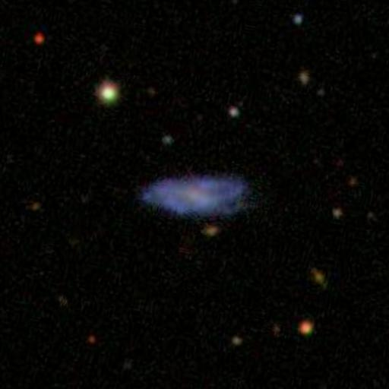
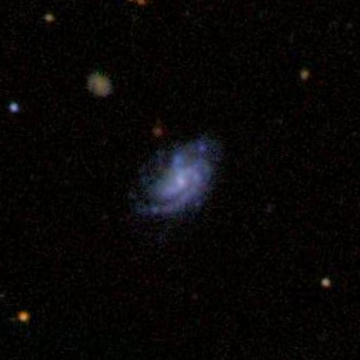
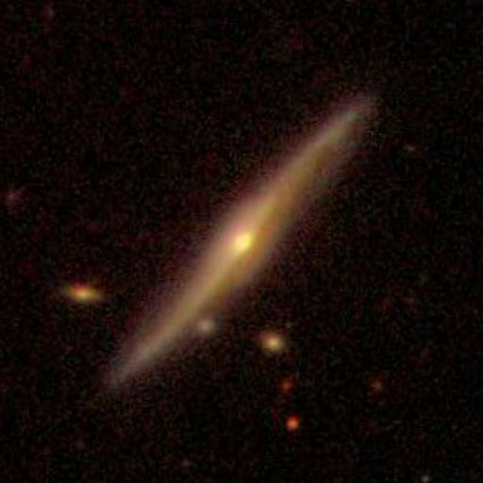
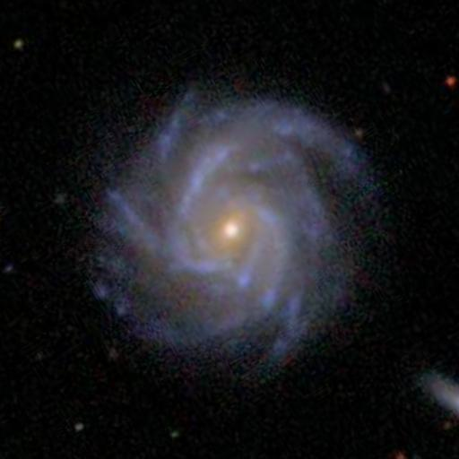
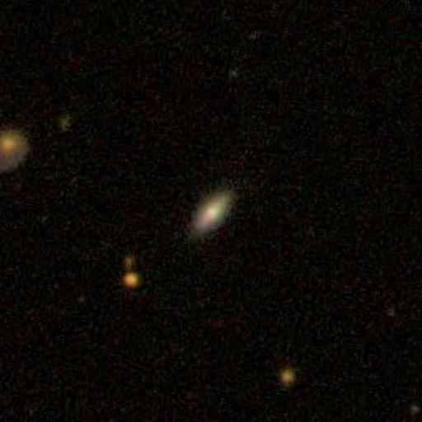
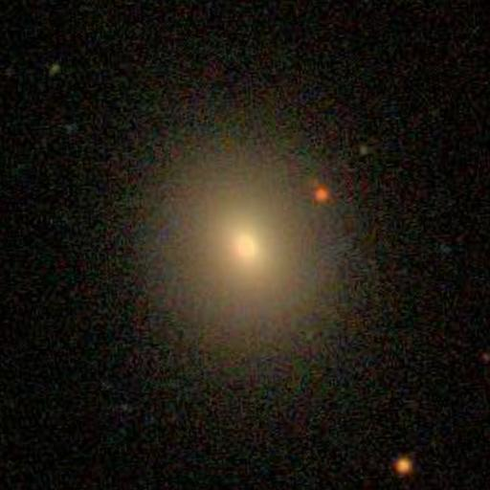
Notes:
Selection is dim
Featured: 587738615951065195 0.0545076 0.948941
Smooth: 588297864192458816 0.710452 0.177523
Selection is mid1
Featured: 587738946676719656 0.00857118 0.984678
Smooth: 587725979616346223 0.587785 0.436185
Selection is mid2
Featured: 587741600954712170 0.0722414 0.907000
Smooth: 588017704002322454 0.792188 0.184284
Selection is bright
Featured: 587736584436777018 0.00000 0.990000
Smooth: 587736523764465741 0.871157 0.0580000
All images 0.19806”/pix, 512x512 (1.7arcmin sq)

Slide 4
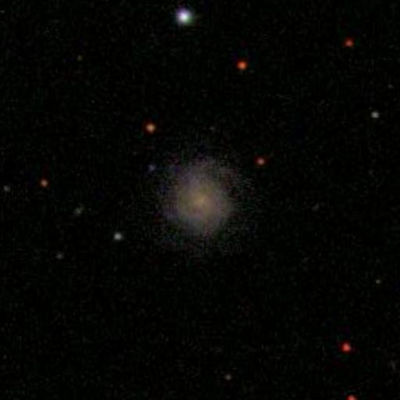
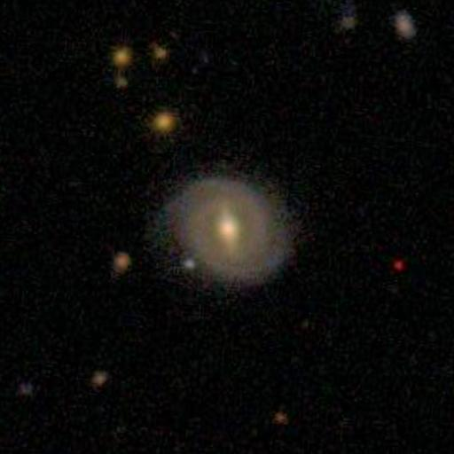
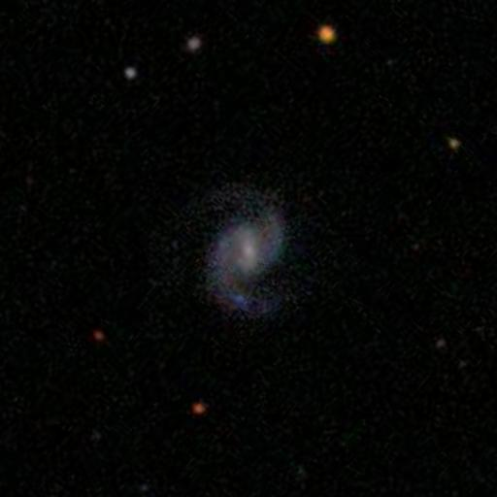
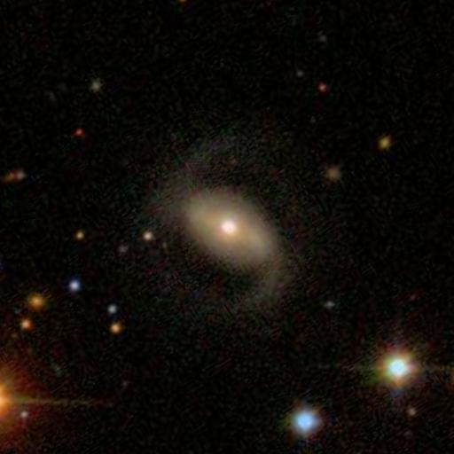
Notes:
Top right: 15 13
587738409259040831 167.487 13.4580 -20.7433 0.771530 0.850500
Bottom right: 5 3
588017978915160212 242.810 24.2250 -21.3174 0.852940 0.0490000
Top left: 130 114
587729971255902586 230.587 -1.57037 -19.8088 0.246194 0.867660
Bottom left: 51 45
587731680654983426 132.062 41.1865 -19.1363 0.189383 0.194521
All images 0.19806”/pix, 512x512 (1.7arcmin sq)

Slide 5
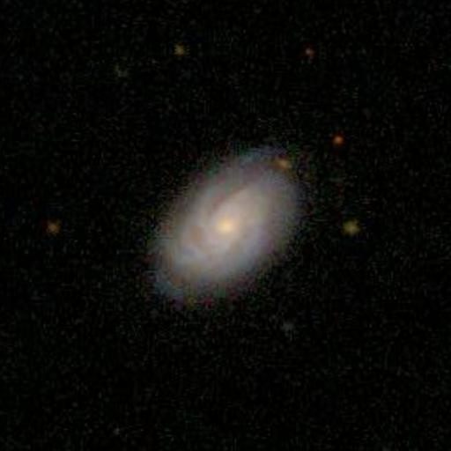
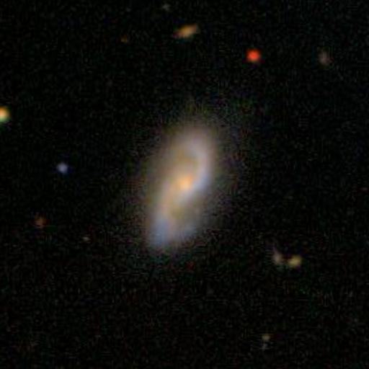
Notes:
Top right: 9 -1
587742061082968233 209.514 20.4013 -21.1289 0.812376 0.770063
Bottom right: 4 0
587738196652982642 121.055 55.3977 -21.9214 0.751784 0.212000
Top left: 16 0
587742772949418053 183.288 16.2969 -21.3421 0.239769 0.786208
Bottom left: 1 0
587728310175465540 167.100 3.49796 -21.1936 0.248359 0.233235
All images 0.19806”/pix, 512x512 (1.7arcmin sq)

Slide 6
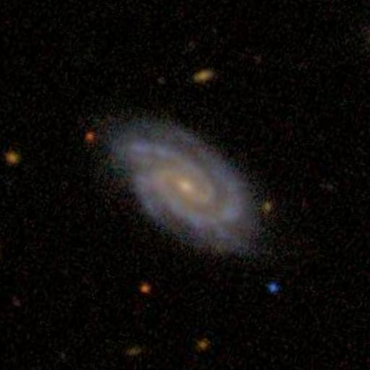
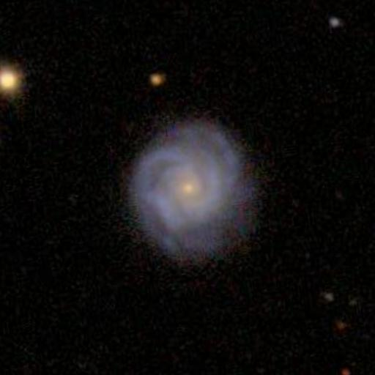
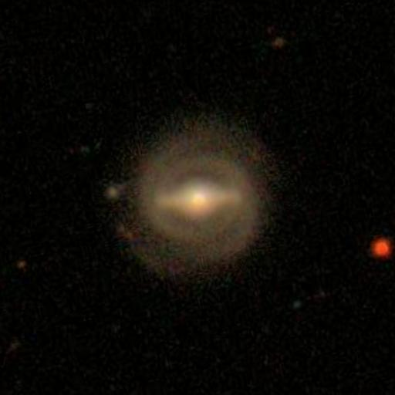
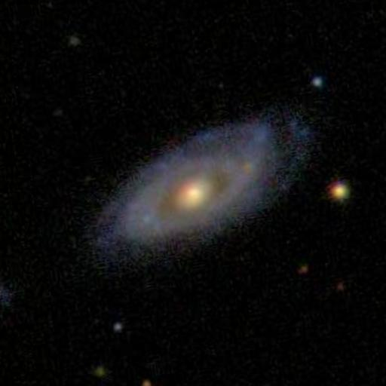
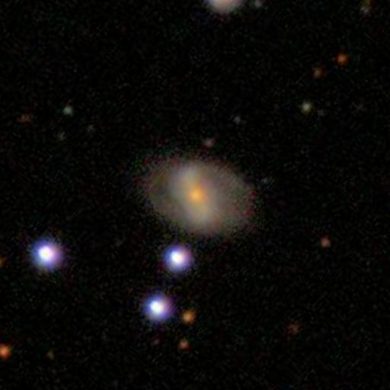
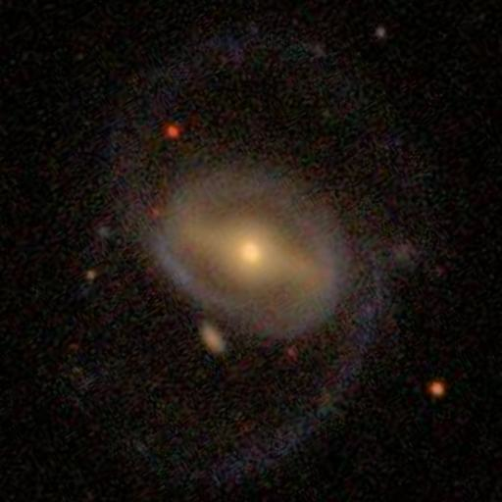
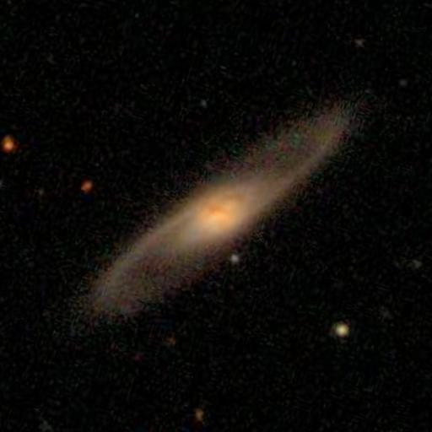
Just noticeable bulge
Dominant bulge
Tightly wound arms
Loosely wound arms
Notes:
Top right: 2 -1
587738953105473543 206.475 36.5659 -21.0461 0.768821 0.901289 1.00000
Bottom right: 2 0
587738196652982642 121.055 55.3977 -21.9214 0.751784 0.212000 1.00000
Top left: 1 0
588023239134937193 140.136 17.7022 -21.0369 0.219800 0.866500 0.667000
Bottom left: 0 0
588018056203206872 253.591 25.8716 -21.0216 0.309919 0.464066 0.752322
Unbarred
Top right: 7 -1
587742061082968233 209.514 20.4013 -21.1289 0.812376 0.770063 0.0179113
Bottom right: 0 0
587742550688989269 238.350 12.0586 -21.0211 0.227320 0.766401 0.128497
Top left: 12 1
587735428542627874 194.399 48.4874 -21.5122 0.224872 0.907033 0.0335490
Bottom left: 1 0
587728310175465540 167.100 3.49796 -21.1936 0.248359 0.233235 0.135467
All images 0.19806”/pix, 512x512 (1.7arcmin sq)

Slide 7
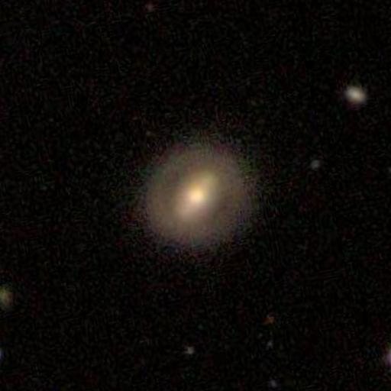
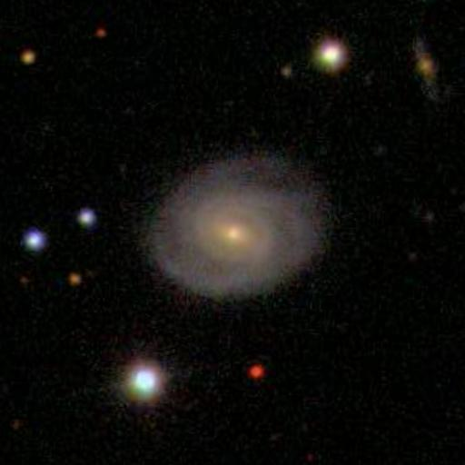
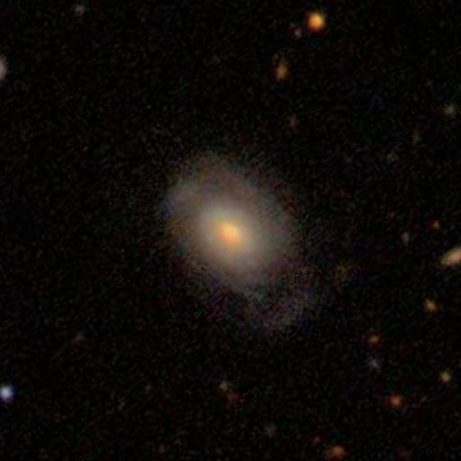
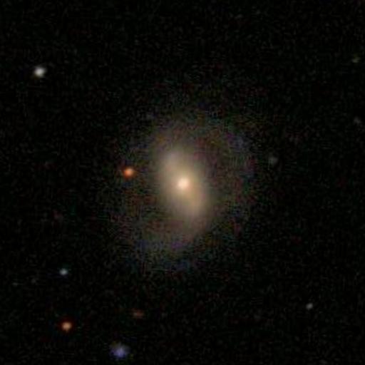
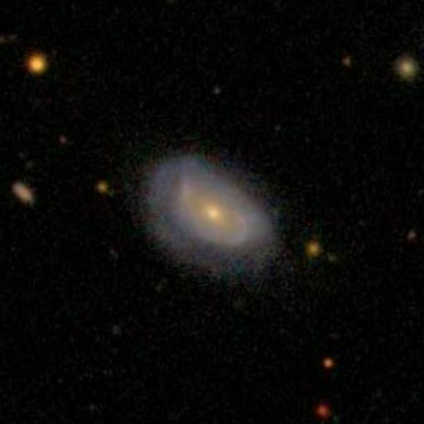
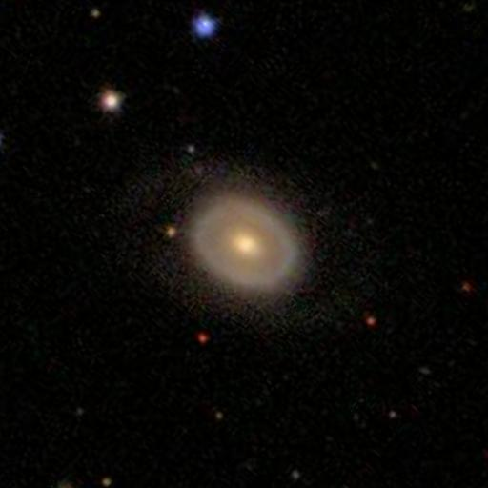
P_{bar}= 0.92
P_{spiral}= 0.21
P_{bar}= 0.34
P_{spiral}= 1.00
P_{bar}= 0.07
P_{spiral}= 0.60
P_{bar}= 0.95
P_{spiral}= 0.81
P_{bar}= 0.06
P_{spiral}= 0.30
P_{bar}= 0.04
P_{spiral}= 0.08
Notes:
Pbar>0.5 1115 0.250112
Example: 587733196234817578 198.694 54.0874 0.916677 0.213279
0.2<Pbar<0.5 1019 0.228578
Example: 587728879801270400 149.246 3.81305 0.338413 1.00000
Pbar<0.2 2324 0.521310
Example: 587728906636886170 117.518 34.4793 0.0699845 0.597951
Pspiral>0.5 3467 0.777703
Example: 587735349641478199 167.364 15.2802 0.945098 0.813468
0.2<Pspiral<0.5 655 0.146927
Example: 587738952029569092 200.210 36.6138 0.0551886 0.289725
Pspiral<0.2 336 0.0753701
Example: 587733603730391053 245.694 39.5846 0.0391164 0.0836190

